Slide 1
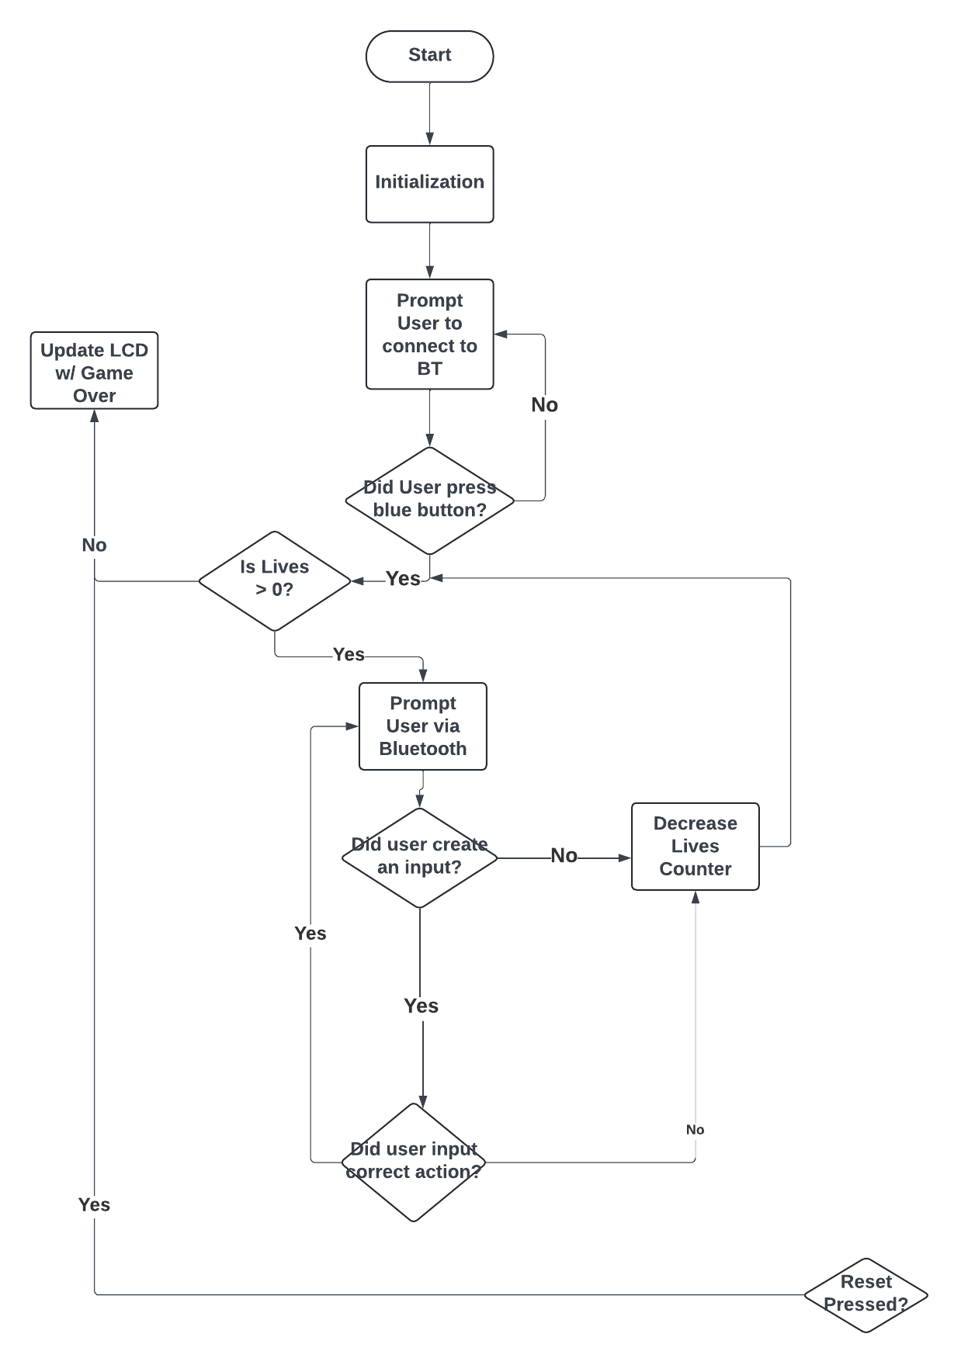
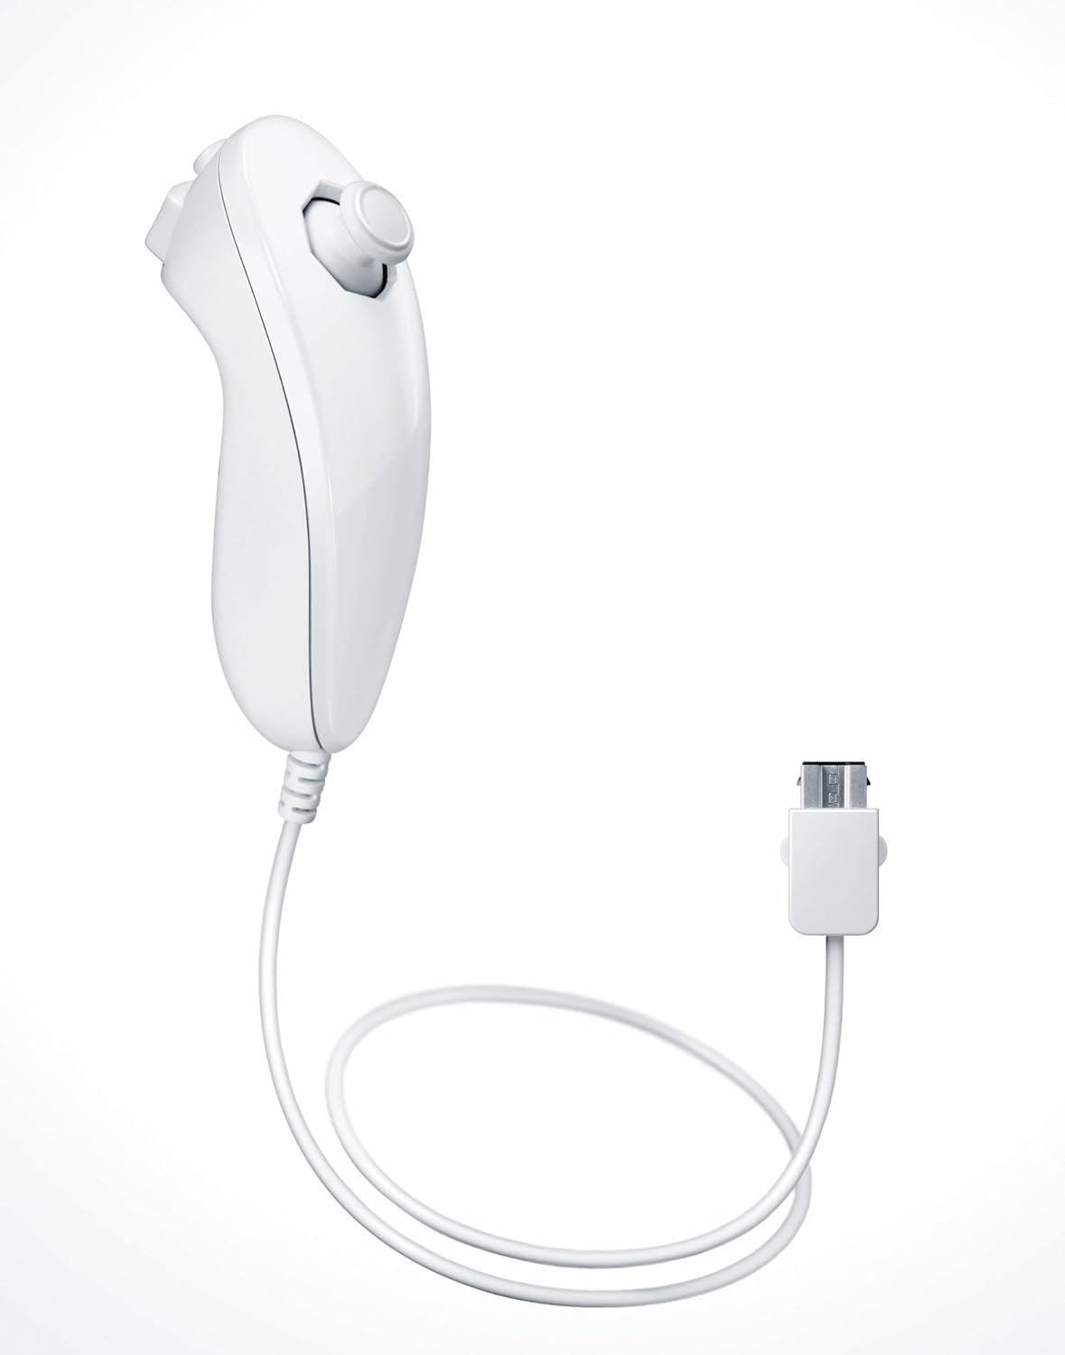
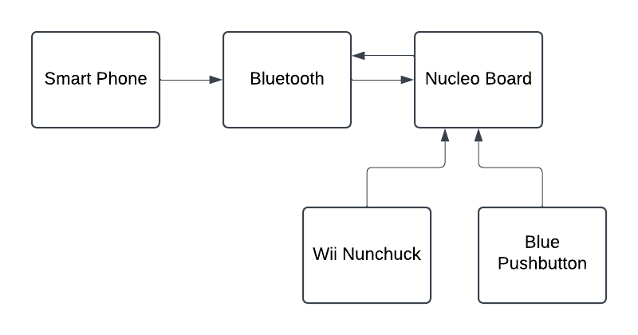

NUCLEO SAYS
Objective
Create a Bop It/Simon Says game on the Nucleo development board
Communicate with iPhone over Bluetooth
Perform moves with the Nunchuck and Blue Pushbutton
Actions
Twist it! – Move the Joystick
Z-it! – Press Z button on nunchuck
C-it! – Press C button on nunchuck
Shake it! – Shake the nunchuck
Push it! – press the blue button built into the Nucleo board
COEN-4720 Embedded Systems
Electrical and Computer Engineering, Marquette University
Hayley Jamiola & Annaliese Winklosky
How it works
Moves are sent to the device connected via Bluetooth
The user must perform the correct action
If the action was correct, the score will be incremented
Image of Wii Nunchuck
Communication
Communication is done over Bluetooth
User actions are prompted through a connected phone on BLE Serial Tiny
Graphics
The heart shown below represents a life in Nucleo Says on the LCD.
The player will start with three lives, and every time they do not perform an action correctly, they will lose a life.
Flow Chart
Block Diagram
Notes:
Both – intro
Hayley – Objective/Background/How it works/Graphics
Annaliese – actions/communication/diagrams
Annaliese.Winklosky@gmail.com

Slide 2
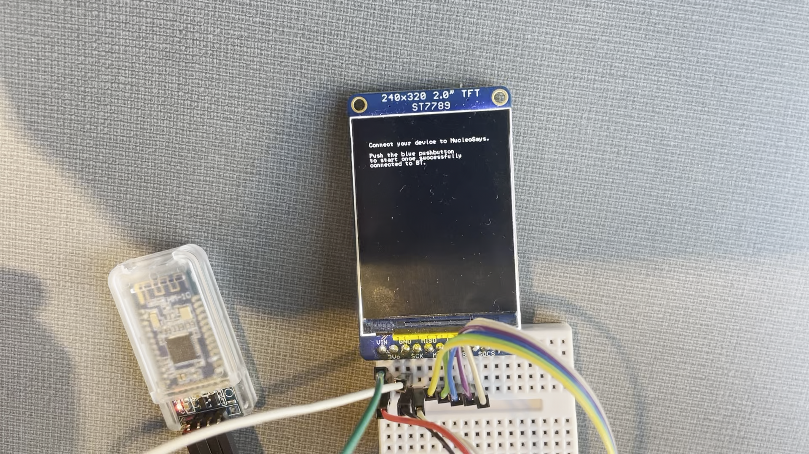
Video Demonstration

